Slide 1
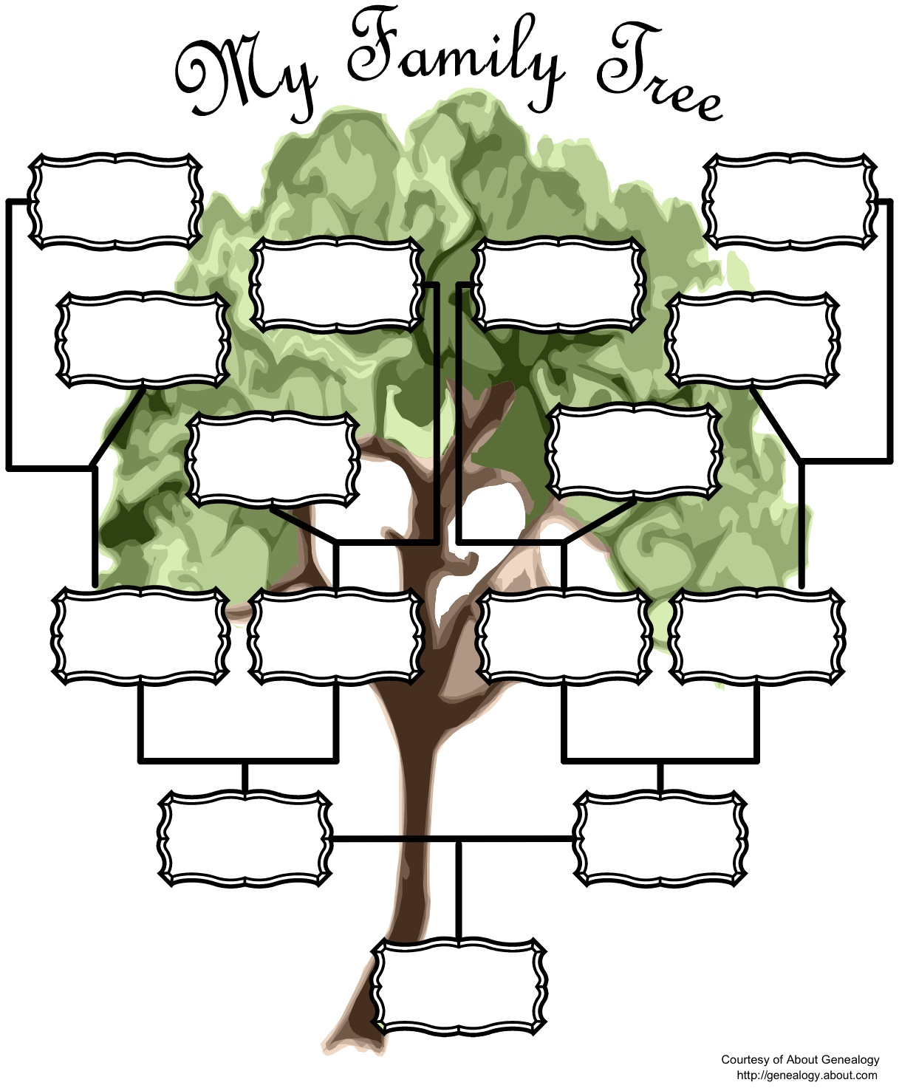
Year 7 PSHCE Self-Study – January Task
This half-term you'll be learning about friends, families and relationships.
As part of that, we'd like you to try and create your own family tree, a little bit like the one on the right, or you can google some other examples if you'd like to.
A family tree is designed to show who you're related to, but not just the people you live with, how many other relatives do you have that you can connect with?
Try to go as far back as you can, and even ask your parents/carers if there's family you've never even met before that you might be able to add on too!

