Slide 1
DT Curriculum intent:
We aim for students of all aspects of Design & Technology/Food and Nutrition/3D Design/Textiles to:
Be inspired
Develop a range of life skills
Feel able to experiment independently
Have the freedom to be creative and build their resilience.
Notes:
1

Slide 2
WALT:
In this homework activity we are learning to:
Knowledge: To know how to research a theme and an idea thoroughly.
Key words:
Research
Appropriate
Why do we do textiles in school?
IKEA: A world without textiles // ИКЕА: Свят без текстил - YouTube
WILF | Good progress | Better Progress | Even better progress
Research | They use some ideas from others’ designing to inform their own work. | They use understanding of others’ designing as they develop their work. Pupils develop ideas by drawing on and using various sources of information. | They recognise the significance of others’ designing and modify their approaches accordingly.
DT
Notes:
2

Slide 3
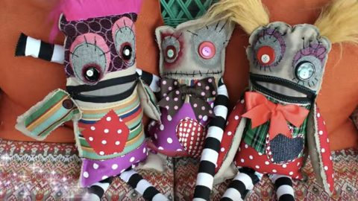
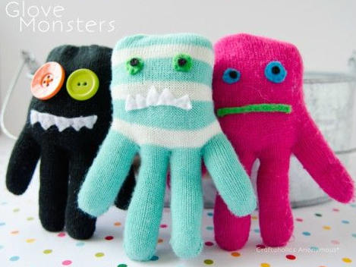
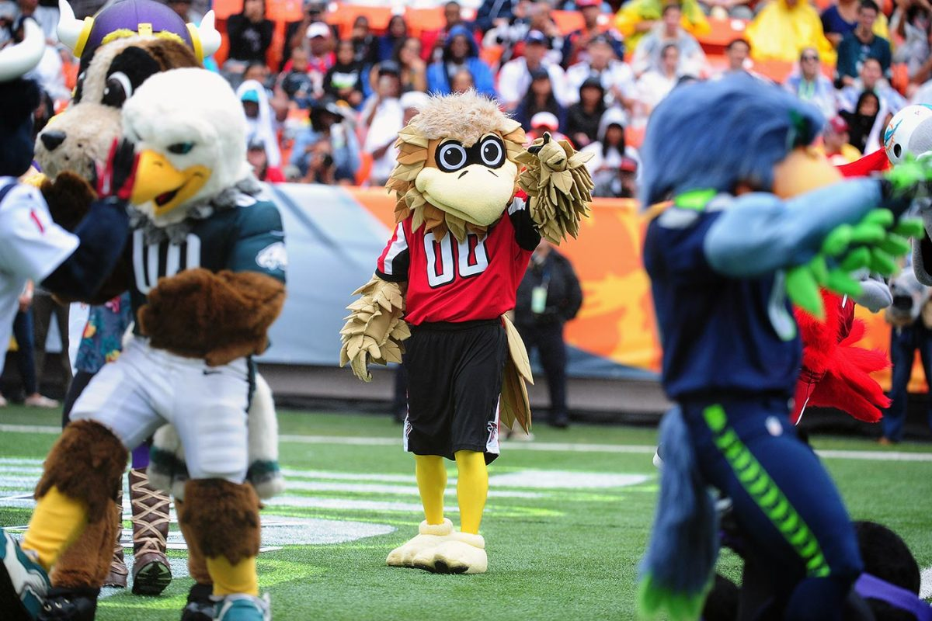

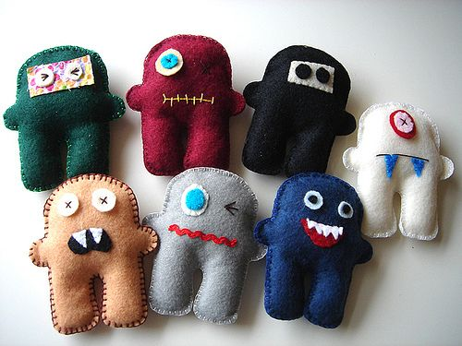
Homework task: Collect images to inspire your project
Get pictures of toys, mascots and house/school logos
Save the pictures on a word or PowerPoint file and attach to the assignment in Teams.
Anything goes, you can even make them out of old socks or gloves!
Above: NFL mascots
Left: The Tokyo 2020 Olympic Mascots

