Slide 1

Contents
Learning Outcome 1 – understand the issues which affect participation in sport
Learning Outcome 2 – know about the role of sport in promoting values
Learning Outcome 3 – understand the importance of hosting major sporting events
Learning Outcome 4 – know about the role of national governing bodies in sport.
Unit R051:Contemporary Issues in Sport

Slide 2
Learning Outcome 1 – Understand the issues which affect participation in sport
Factors Impacting the popularity of sports in the UK
Unit R051:Contemporary Issues in Sport

Slide 3

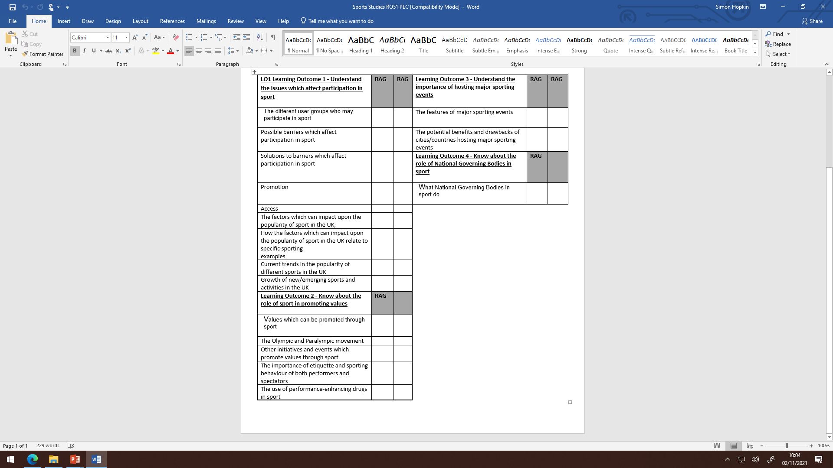
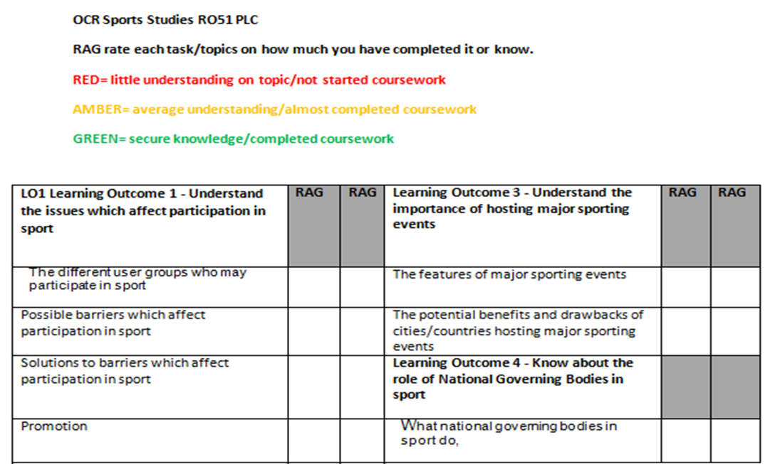
Self assess

Slide 4
Learning Outcome 1 – Understand the issues which affect participation in sport
Mock Exam Question Focus
Q18.
Discuss the influence of the media on the popularity of sport.
(8 marks)
Highlight and annotate the question with key words.

Slide 5
Learning Outcome 1 – Understand the issues which affect participation in sport
Exam Question Focus – How to structure an answer to an 8 mark question
Discuss the influence of the media on the popularity of sports. (8)
Discuss = say why/because/ give reasons/good and bad points
Influence of the media= What does the media do to impact sport?
Popularity = positive/negative
Sports = more than 1 sporting example

Slide 6
Learning Outcome 1 – Understand the issues which affect participation in sport
Exam Question Focus – Mark Scheme
Level 3 (7–8 marks)
At the top of the level candidates show a well-developed understanding of the relationship between media coverage and participation/ popularity/spectatorship.
At the top of the level candidates will discuss both the positive and negative impact media can have on the popularity/spectatorship/participation
To access this level candidates are able to give at least three knowledge points and three examples from sport that show that media coverage can affect popularity/participation/ spectatorship.
Level 2 (4–6 marks)
Candidates show an understanding of the relationship between media coverage and increased popularity/participation/spectatorship.
At the top of the level candidates will discuss both the positive and negative impact media can have on the popularity/ participation/ spectatorship.
To access this level candidates are able to give at least two knowledge points and two examples from sport that show that media coverage can affect popularity/participation/ spectatorship.
Level 1 (1–3 marks)
Basic understanding that more media coverage results in increased participation or spectatorship.
At the top of this level candidates will be able to give at least one knowledge point and development.
Limited or no examples used

Slide 7
Learning Outcome 1 – Understand the issues which affect participation in sport
Exam Question Focus
Q18.
Discuss the influence of the media on the popularity of sports.
(8 marks)
Plan your answer in bullet points

Slide 8
Learning Outcome 1 – Understand the issues which affect participation in sport
Exam Question Focus – How to structure an answer to an 8 mark question
Discuss the influence of the media on the popularity of sports.. (8)
Knowledge Point 1 =
Development of Knowledge =
Positive or negative influence =
Sporting Example
Knowledge Point 2 =
Development of Knowledge =
Positive or negative influence (if positive in paragraph 1 must be negative in paragraph 2) =
Sporting Example
Knowledge Point 3 =
Development of Knowledge =
Positive or negative influence =
Sporting Example

Slide 9
Learning Outcome 1 – Understand the issues which affect participation in sport
Exam Question Focus
Q1.
Discuss the influence of the media on the popularity of sports.
(8 marks)
Now answer the question

Slide 10
Learning Outcome 1 – Understand the issues which affect participation in sport
Exam Question Focus – Answers – Peer Mark
Positive
1.
(More) media coverage raises the profile of the sport
· Raises awareness among potential participants
· Makes sport more popular/increases participation
· E.g. Cycling post-Olympic coverage
2.
Increased funding from sponsorship/ media rights
· Many current sports initiatives are funded through the sale of media rights
· More money to sport can help increase popularity
· E.g. Media rights for football generate huge revenues some of which are invested in ‘grass roots’ initiatives.
3.
(Increased media coverage) can increase opportunities for watching sport/spectatorship making it more popular.
· Increased media coverage enables more people to watch sport
· Increases awareness of opportunities to spectate at live sports events.
· Increased awareness of the rules of the sport

Slide 11
Learning Outcome 1 – Understand the issues which affect participation in sport
Exam Question Focus – Answers – Peer Mark
4.
Media raises awareness of where to play sport
· Promotion of sports facilities in the media raises awareness of where people can play sport
· E.g. where national standard facilities are located
5.
Promotes role models/high profile sports performers
· Role models promoted through extensive media coverage can inspire more people to take part in sport
· E.g. Usain Bolt
6.
Can be used to advertise sports initiatives
· Media campaigns are used to promote/advertise opportunities to play sport
· E.g. Sport England’s ‘This Girl Can’ campaign
· E.g. Sky Sports and the Women’s Sports Trust teaming up for the ‘time to show up’ campaign

Slide 12
Learning Outcome 1 – Understand the issues which affect participation in sport
Exam Question Focus – Answers – Peer Mark
Negative
7.
Sports not covered as well in the media can suffer
· Limited/no media coverage can adversely affect participation
· E.g. volleyball rarely seen in the media, so less people play it
8.
Media can reinforce stereotypes about sports
· Limited women’s sport coverage can reinforce views and reduce popularity/spectatorship
· E.g. Low coverage of women’s sport reinforces view that men are better at sport than women
· So women’s sport is not watched as much as men’s sport

Slide 13
Learning Outcome 1 – Understand the issues which affect participation in sport
Exam Question Focus – Answers – Peer Mark
9.
Negative portrayal of a sport in the media
· Sport can be portrayed as aggressive/violent
· So less people participate or watch, popularity decreased
· E.g. boxing, horse racing
· E.g. Cycling and athletics linked to systemic doping
10.
Increased spectatorship via media can negatively affect participation
· Could also have negative impact as people watch sport instead of taking part or watching sport becomes so frequent
· E.g. variation of kick off times due to media coverage can mean people able to watch all the time

