Slide 1
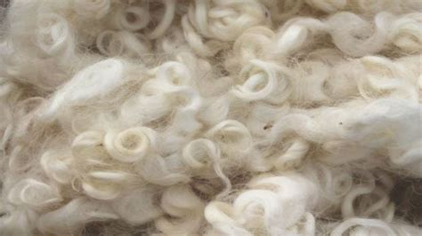
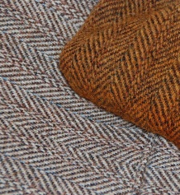
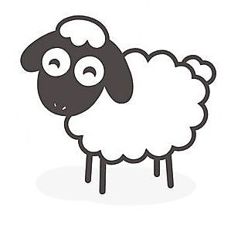
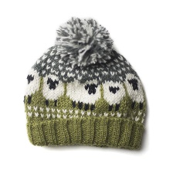
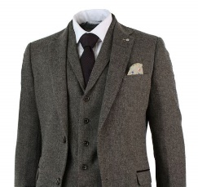
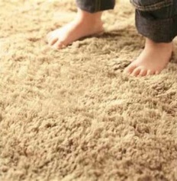
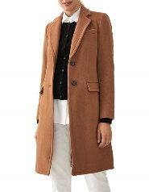
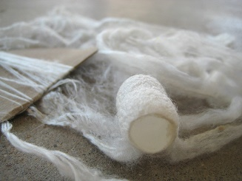
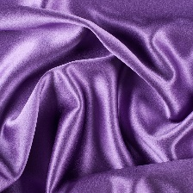

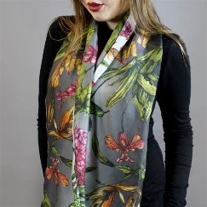
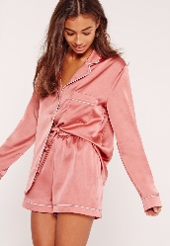
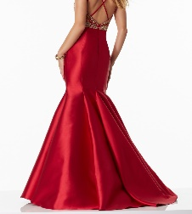
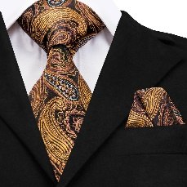
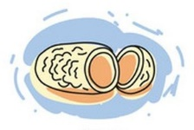
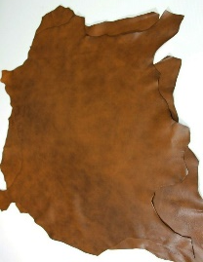
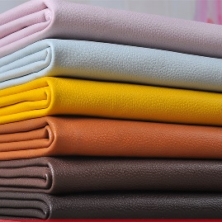
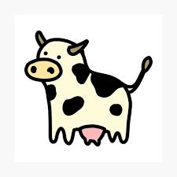
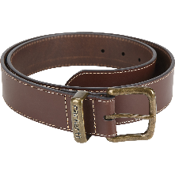
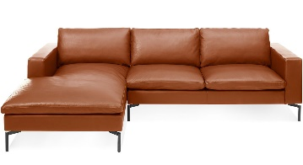
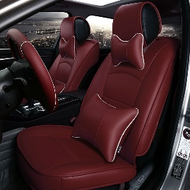
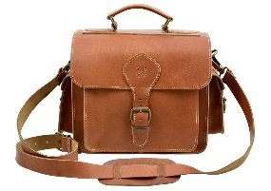
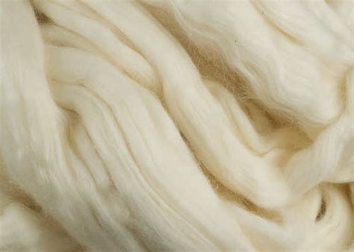
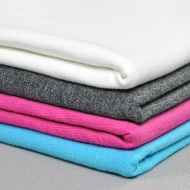
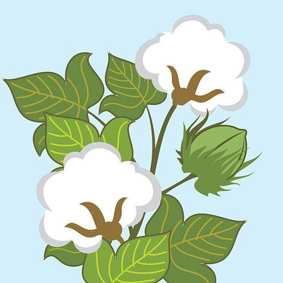
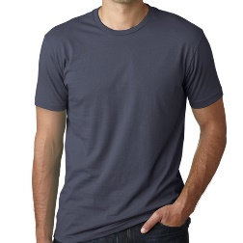
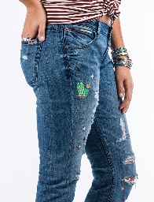
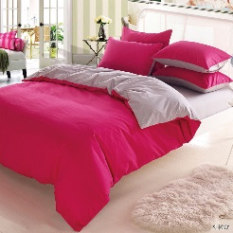
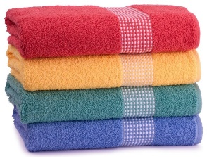
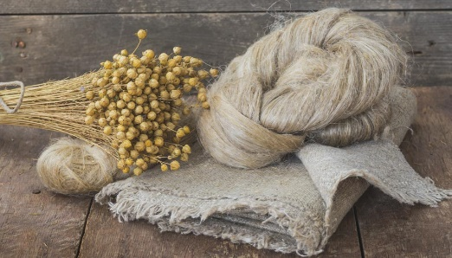
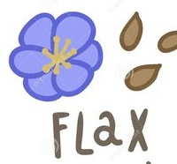
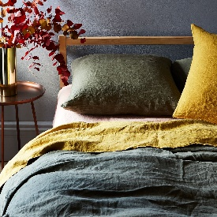
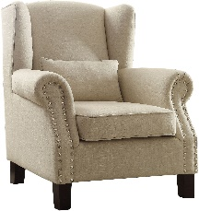
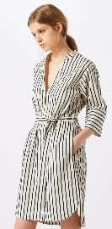
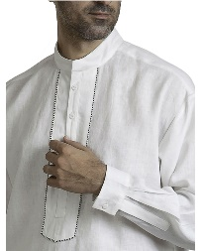
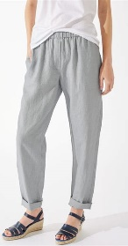
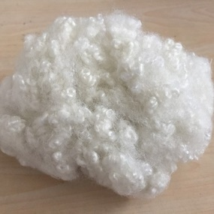
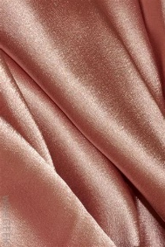
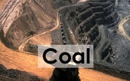
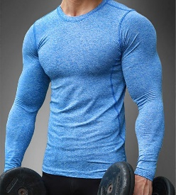
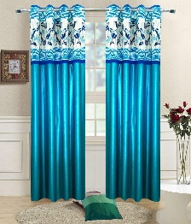
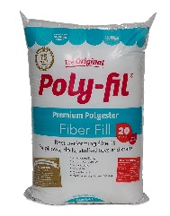
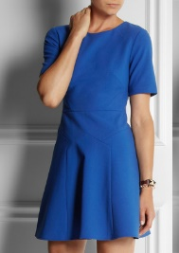
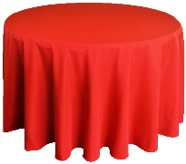
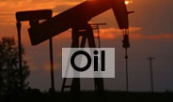
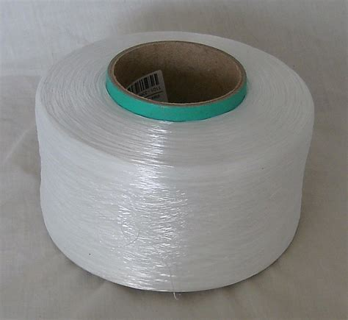
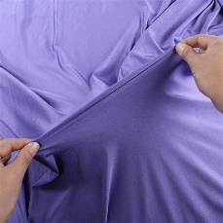
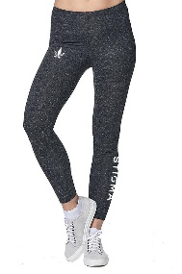
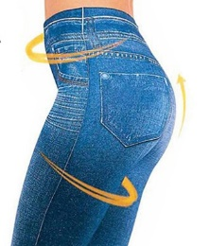
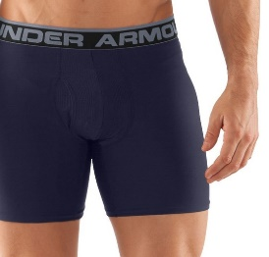
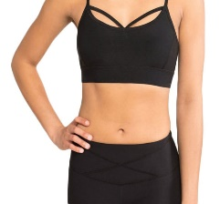










Name: ____________________________ Date: / /
Textiles
 | Name | Sample / Picture | Source / Info |  | Uses |  | Properties
 |  |  |  |  |  |  | Positives | Negatives
N____________ fibres | W______ |  |  | Animal fleece, most commonly from sheep |  |  | Warm, crease resistant, low flammability, sustainable
 | S_______ |  |  | Very fine natural protein fibre from silkworm cocoon | Scarves, nightwear, dresses, ties |  |  | Creases easily, expensive, doesn’t wash well, ethics
 | L________ |  |  | From the skin / hide of animals, usually cows |  |  | Doesn’t fray, holds its shape, long lasting, sustainable
 | C________ |  |  | White fluffy “boll” taken from the cotton plant | T-shirts, jeans, bedding, baths towels |  |  | Creases, flammable, poor elasticity, dries slowly
 | L________ |  |  | Stems of flax plants produce long, soft strong and flexible fibres |  |  | Very cool in hot weather, dyes well, sustainable
S______________ fibres | P________ |  |  | Can be made into different fabrics including satin (resembling silk) | Clothing, curtains, cushion filling, tablecloths |  |  | Flammable (melts), not biodegradable, not sustainable
 | E________ (L_______) |  |  | Smooth to touch with a sheen |  |  | Extremely elastic, dries quickly, doesn’t crease, cheap
T___________ T_________ | K_______® |  |  | Hot Polymer is forced through a sieve creating fibres that are woven. | Bulletproof vests, motorcycle jackets, reinforcing tyres.
 | C________ f_______ |  | Substrate varies, metal. | Substrates typically include cotton / polyester with woven Copper wire |  |  | Conducts electricity - metal strands woven into the textile or yarns have a metal-coating.

